Slide 1
The Good News About Oysters
Nature’s Super Food | Exciting Market Growth | Solid Investment Opportunities
Notes:
This presentation should take around 10 minutes to present.
It is written based on the assumption that your audience has no real knowledge of the oyster industry.
Feel free to adapt it for your own use and insert your own information and photos into Slides 10 & 11.
Depending on your audience, you may like to point out/explain what the photos depict on each slide.
It is important that you share your insight and knowledge about the industry rather than just read in rote from the notes.
Good luck!

Slide 2
Sit back and relax…
With thanks to NSW South & Bega Coast Oysters
Notes:
Play this video to set the scene for the presentation
- You need internet access to show this video
You need speakers/sound to hear background music
Double click on the picture to start the video
Run time: 2 mins 16 secs

Slide 3
The History of Oysters in Australia…
Oysters – an important food source for Aboriginal people for thousands of years.
European settlement decimated
native food stocks as a source of:
Food
Lime for cement
production
Systematic cultivation of oysters
started in the 1870s
Source: Dictionary of Sydney
Notes:
Australia’s indigenous people have used oysters as a valuable food source for many thousands of years.
Oyster middens (piles of shells) in the Sydney area have been carbon-dated to around 10 000BC.
European settlement and a rapidly growing population saw the demand for oysters, as a food source and a source of lime for cement production, severely deplete wild oyster stocks.
As a result, systematic cultivation of oysters in Australia started in the 1870s.

Slide 4
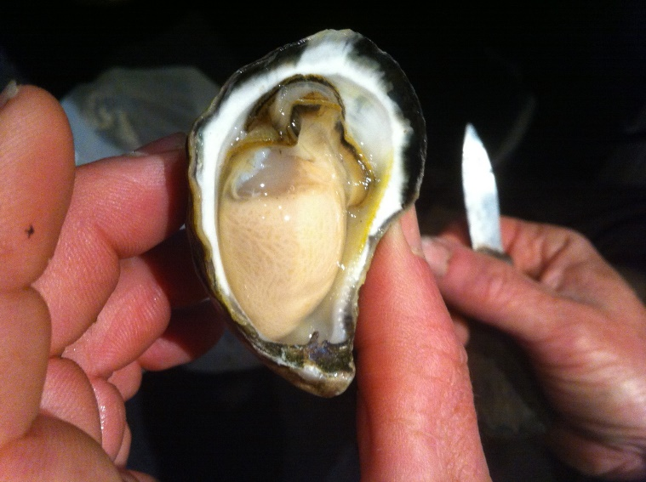
Oyster Basics…
A delicious Sydney Rock Oyster
SYDNEY ROCK OYSTER
Native to Australia
Found between Hervey Bay (QLD) &Wingan Inlet (VIC)
Farmed extensively throughout NSW
90% of production in NSW
3-4 years to reach market size
PACIFIC OYSTER
Introduced to Australia from Japan in the 1940s
Mostly grown in SA, Tasmania & selected NSW estuaries. Considered a noxious species in other waters.
18 months to reach market size
Source: Tathra Oysters
Notes:
Sydney Rock oysters (Saccostrea glomerata) are endemic to Australia and are found between Hervey Bay (QLD) and Wingan Inlet (VIC).
Sydney Rock oysters are farmed extensively throughout NSW, and account for over 90% of oyster production in the state.
It can take 3-4 years for a Sydney Rock oyster to reach market size.
Pacific oysters (Crassostrea gigas) were originally introduced into Australia from Japan in the 1940s, and are now grown in South Australia, Tasmania and in select estuaries in NSW.
Pacific oysters grow quicker than Sydney rock oysters, and can reach market size in just 18 months.
They have been cultivated commercially in Port Stephens since 1991, but are declared a noxious species in all other waters.

Slide 5
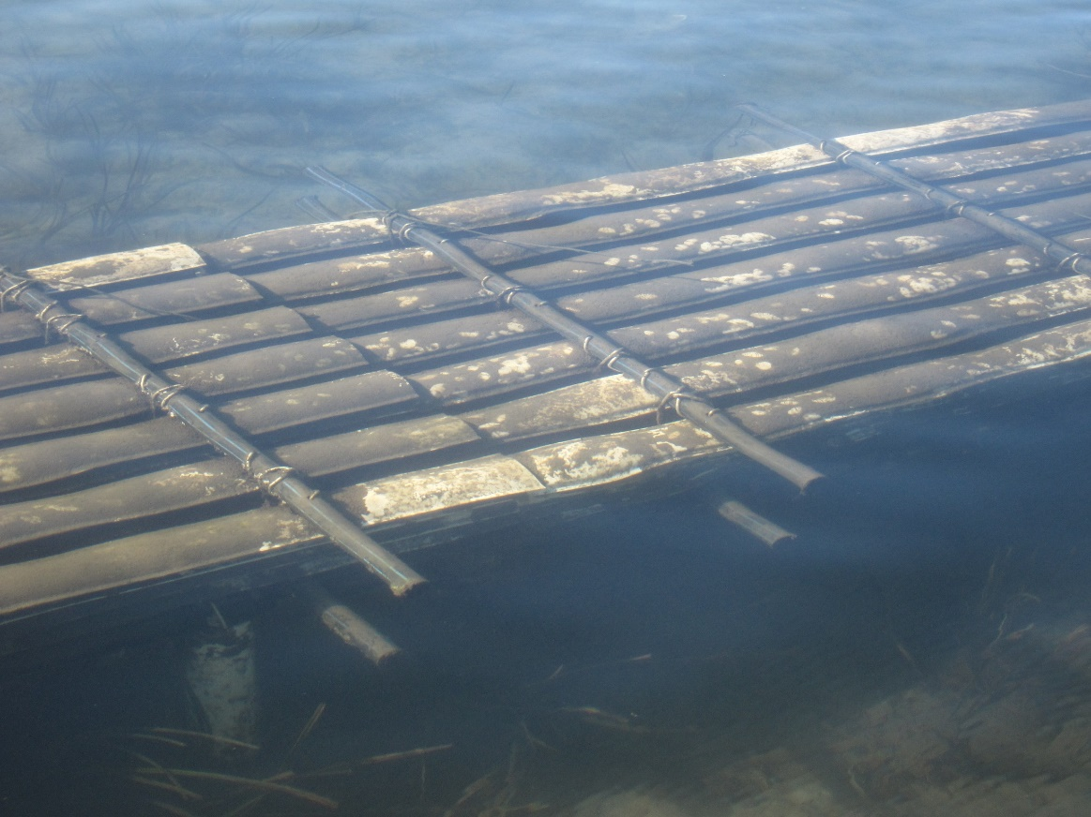
The Oyster Lifecycle…
During spawning each female can release up to 20million eggs.
The fertilised eggs float in the water for 3-4 weeks seeking a safe place to attach an grow.
Once they attach, they are described as SPAT.
Underwater slats, placed closely together, shelter the spat from birds and fish
Source: OceanWatch Australia
Notes:
Baby Oysters or ‘Spat’
Oysters spawn into their surrounding waters between December and June each year.
Each female oyster may release up to 20million eggs, but only about 0.1% survive.
Once the eggs are fertilised, they drift around in the water for three-to-four weeks seeking suitable places to attach themselves and grow.
Oyster farmers provide purpose-built underwater slats or racks that provide a comfortable and convenient home for the larvae to settle and also protect them from predators such as birds and fish.
Once the larvae attach themselves to the slats, they are then known as spat.

Slide 6
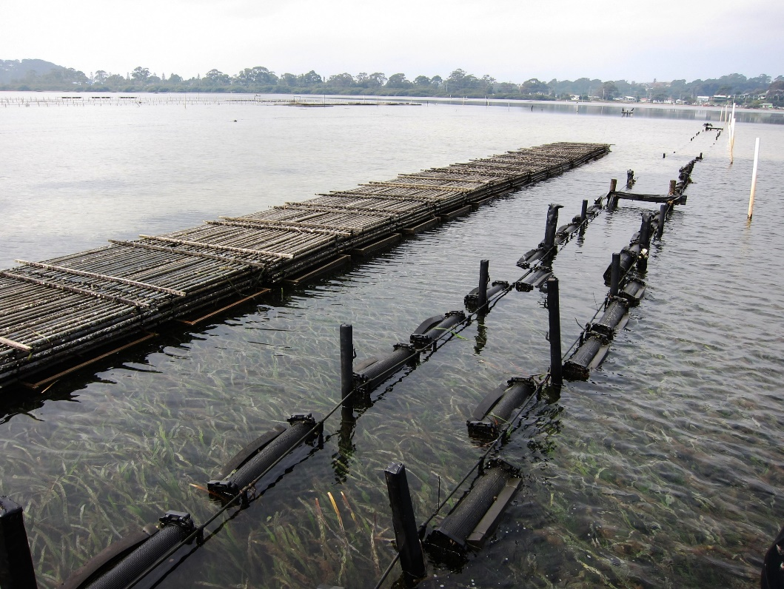
The Oyster Lifecycle…
Once the spat reach 10mm in size, they are removed from the water and sorted into similar size ranges.
They are then returned to the water to grow.
Farmers can use a variety of different in-water systems to grow out the oysters.
Source: OceanWatch Australia
Notes:
GROWING
Once the spat reach about 10mm in size, oyster farmers lift the spat from the water, remove them from the slats, sort them into similar size ranges and place them back into the water in oyster containers.
There are four different systems used to grow out the oysters to maturity;
(1.) the traditional ‘rack and rail’ system,
(2.) the long-line system
(3.) the floating bag system and
(4.) the raft system.
The choice of method is dependent on the specific lake and river systems, their local environmental conditions, lease location and personal farmer choice driven by the best outcomes for growth and animal husbandry etc.

Slide 7
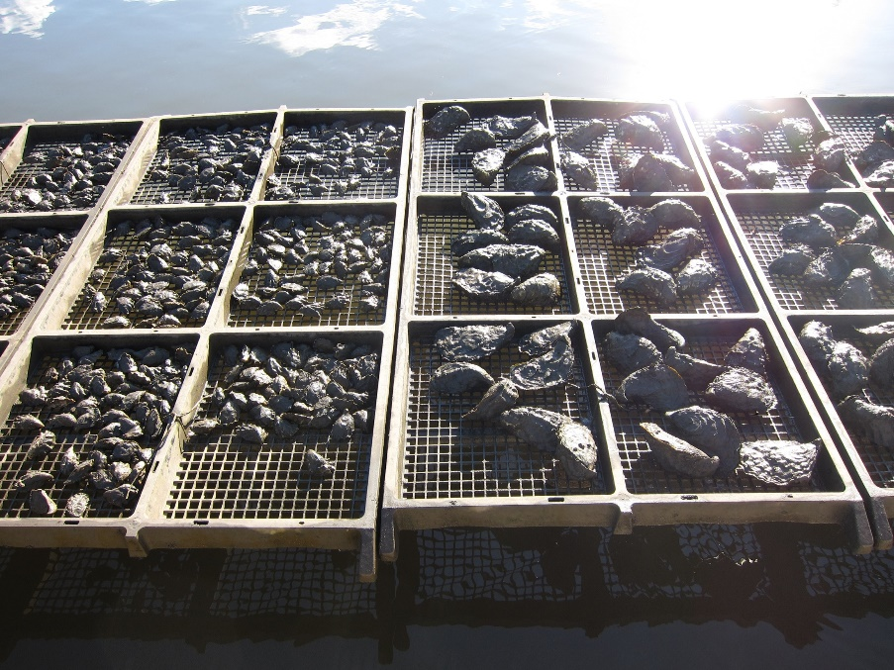
Harvesting…
Oysters are graded once or twice per year, sorted into similar sizes, and then returned to the water for further growing.
The final grading process is completed by hand or using a computerised machine and sorts the oysters by size, into:
Plate (Very Large)
Bistro (Large)
Bottle (Medium)
Cocktail (Small)
Harvest time is driven by estuary location
Source: OceanWatch Australia
Notes:
Harvesting
The harvesting of oysters takes place when a majority of the oysters for that season have reached a size and condition considered to be ready for market.
The grading process is completed by hand or using a computerised machine and sorts the oysters by size, into:
Plate (Very Large)
Bistro (Large)
Bottle (Medium)
Cocktail (Small)
Seasonality of Harvest
Sydney Rock Oysters across NSW are harvested at various times of year, dependant on their location.
South Coast oyster farmers traditionally harvest and sell from prior to Christmas to the start of Winter or early July, while Georges Basin and Sydney estuaries and North Coast NSW Sydney Rock Oysters supply from the end of Winter to late February.

Slide 8
Where do they grow…
Source: NSW DPI Aquaculture
Notes:
Currently there are around 2 238 oyster leases in NSW covering an area of approximately 2 798ha.
Leases are administered by the NSW Government Department of Primary Industries.
Commercial production occurs in 32 estuaries between Wonboyn on the far south coast of NSW to the Tweed River in the north.

Slide 9
My estuary…
Source: OceanWatch Australia

Slide 10
My estuary…
LOCATION:
No. of Oyster Farmers:
No. of dozen oysters produced each year:
Employment Created:
Notes:
Location:
No. of Oyster Farmers:
No. of dozen produced annually
Employment – how many people does the industry employ in your region
Add in other useful facts/information about your region.

Slide 11
My estuary…
Photo
Photo
Notes:
Insert photos here that really capture the beauty and benefits of your estuary. This is your chance to really SELL your region and industry

Slide 12
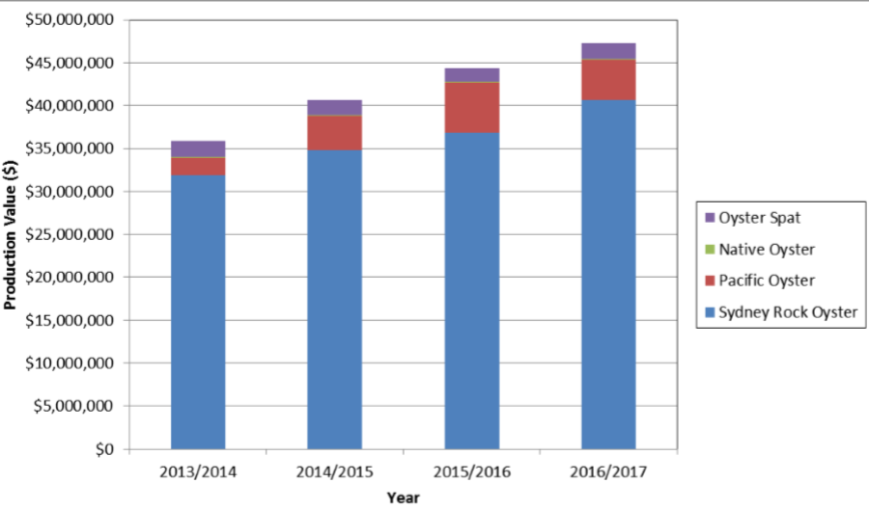
Show me the money!
Make up of the NSW Oyster Industry Production
In 2016/17 annual production of 5.8 million dozen oysters worth $47.3million.
Oyster farming is the most valuable aquaculture industry in NSW.
Source: NSW DPI Aquaculture
Notes:
Oyster production across NSW was up 6% in 2016/17
The value of Sydney Rock Oysters for the year was $40.7m.
The value of Pacific Oyster production for the year was $4.6m.
The value of Oyster Spat production for the year was $2m.
Aquaculture is the fastest growing primary industry in Australia with over 12% growth per year.

Slide 13
How we benefit the community…
Annually an estimated:
output of $226million,
added value of $134million,
$69.3million generated in household income, and
creation of 1 758 full time jobs across NSW.
Source: Magical Oyster Tours
Notes:
A recent study by the NSW Department of Primary Industries estimated that both the NSW aquaculture production and secondary industries have:
an output of $226million,
added value of $134million,
generates $69.3million in household income, and
- creates a total of 1 758 full time jobs across NSW.

Slide 14
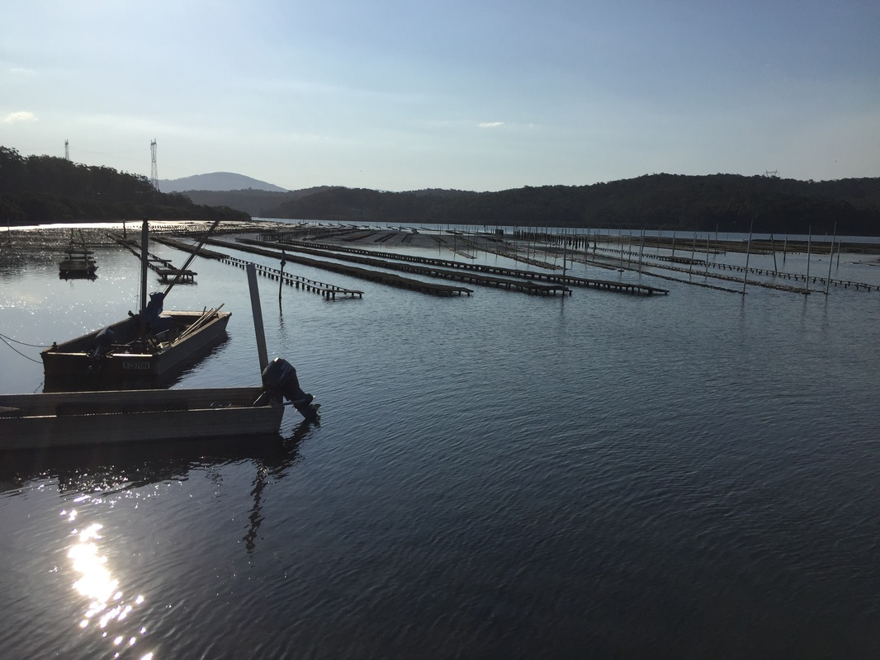
Our environmental impact…
Oysters are considered the canary of the waterway as they are an excellent indicator of estuary health.
Oysters are not fed or treated with any chemicals throughout their lifetime.
The NSW oyster industry are guided by the Oyster Industry Sustainable Aquaculture Strategy (OISAS).
Many oyster-producing estuaries in NSW have voluntarily developed Environmental Management Systems (EMS) that cover their specific waterways.
Source: OceanWatch Australia
Notes:
Oysters are considered the canary of the waterway as they are an excellent indicator of estuary health.
Oyster farmers are the first people to become aware of water quality problems and are often proactive environmentalists. All oysters are filter-feeders, straining organic material from the surrounding water.
They can filter up to 5 litres of water every hour!
Oysters are not fed or treated with any chemicals throughout their lifetime.
The activities of the NSW oyster industry are guided by the Oyster Industry Sustainable Aquaculture Strategy (OISAS).
This strategy records the industry's commitment to environmental sustainable practices and describe their duty of care for the environment.
In addition, many oyster-producing estuaries in NSW have also proactively, and voluntarily, developed Environmental Management Systems (EMS) that cover their specific waterways.

Slide 15
The Good News About Sydney Rock Oysters…
Nutritional benefits of this Super Food
Long shelf life – can live out of water for up to 3 weeks. Longer than any other species
Flavour and provenance characteristics unique to their estuary and seasonal variations.
100% organic & wild harvest
Huge export opportunities.
Significant domestic & international tourism opportunities
Source: Tathra Oysters
Notes:
Few other foods can compare with the nutritional balance of oysters.
The oyster is an easily digestible and nutritious food, rich in minerals (zinc, selenium, magnesium, calcium and iron) and vitamins (A, B1, B2 and C).
Oysters are also considered a superfood in terms of their protein and omega-3 content.
They are low in cholesterol, containing approximately one quarter of the cholesterol of prawns and squid, equal to most other fish. Oysters are well below the cholesterol levels in red meat and some poultry.
The Sydney Rock Oyster is unique in its ability to live out of water for up to three weeks in cool moist conditions.
This is longer than any other oyster variety in the world. Even in a country as vast as Australia, this means that fresh, unfrozen product can be available almost anywhere throughout the year. (https://www.dpi.nsw.gov.au/fishing/aquaculture/publications/oysters/oyster-industry-in-nsw)
Sydney Rock Oyster displays flavour and provenance characteristics depending on the estuary it is farmed in.
They can be sold 12 months of the year with different seasonal flavours and slight changes in colour.
The Sydney Rock Oyster is 100% organic, with no supplementary feeding required.
They can be considered a true ‘wild harvest’ product appealing to the clean and green demands of the market.
The Pacific oyster is currently battling POMS (Pacific Oyster Mortality Syndrome) disease which has dramatically reduced their foothold in the market.
This provides a clear and solid opportunity to expand the Sydney Rock Oyster industry and grow market share.
The export market is virtually untapped. It is believed that the Asian market holds huge potential for oyster producers with the scale and systems to supply this market.
Oyster farmers are great at growing oysters. They also have a range of tourism opportunities to tap into such as farm tours as consumers wish to understand where their food comes from and get closer to the source.

Slide 16
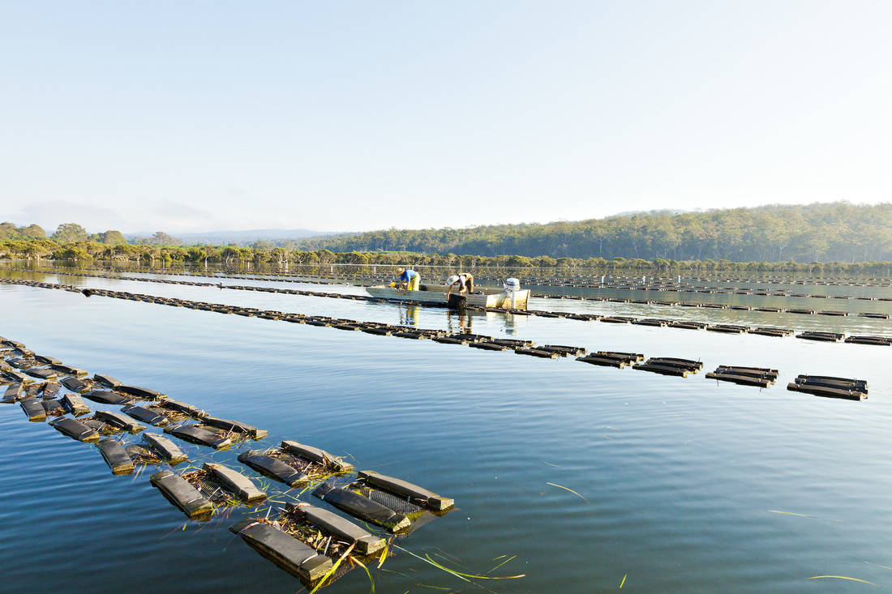
Questions?
For further information:
Contact:
Mob.:
E:
www.
Source: OceanWatch Australia
Notes:
Insert your contact details here and being ready to answer a million questions from an excited audience!

